Slide 1
CSE7302 - INTERNSHIP Review-5 Presentation AI-Based Face Recognition Attendance Management System
Student Details
Name | Tejashwini BV
Roll No | 20231CSE3046
Section | 8CSE09
Under the Supervision of,
Mr . Sakthi S
Assistant Professor
Presidency School of CSE
Presidency University
Name of the Program: B. Tech (CSE)
Name of the HoD: Dr. Asif Mohammed
Name of the Program Internship Coordinator: Dr. R. Balakrishnan, Mr. Sakthi S
Name of the School Internship Coordinator: Dr. Md Ziaur Rahman

Slide 2
Content
About Company or Organization
Working domain or the technology
About your team and reporting Manager
Challenges Faced in Internship
Objectives of the work
Literature Review
Proposed System
Problem Statement
System Requirements
Advantages of Proposed System/Work
System Design
System Implementation
Internship Roadmap
Github Link

Slide 3
About Company or Organization
Rail Wheel Factory (RWF) is a Government of India organization under the Ministry of Railways
Located in Yelahanka, Bengaluru
Focuses on modernization and digitalization of internal system.
Uses software and IT solutions to improve data management and efficiency.
Products & Services
Provides manufacturing and maintenance support to Indian Railways.
Offers technical and engineering services for railway infrastructure.
Uses digital systems for data management and internal operations.

Slide 4
Working domain or the technology
Domain: Artificial Intelligence & Computer Vision
The project is based on Artificial Intelligence (AI) and Computer Vision technologies.
It uses Face Recognition to automatically identify employees/students.
The system captures live video and detects human faces in real time.
Technologies Used
Frontend: React.js, JavaScript.
Backend: Python, Flask.
Database: MongoDB.
AI Libraries: OpenCV, Insight Face.
Tools: VS Code.

Slide 5
About your team and reporting Manager
Individual Leader: Tejashwini BV
Reporting Manager: Buddha Apparao
Worked under guidance with structured tasks and regular reviews.

Slide 6
Challenges Faced in Internship
Difficulties with library installation, dependency management, and environment configuration.
Camera integration issues and OpenCV-related errors during development.
Challenges in optimizing system accuracy and improving overall performance.
Time management difficulties while balancing learning new technologies and active project development.
Steep learning curve in understanding AI concepts and face recognition algorithms.

Slide 7
Objectives of the work
To create an AI-based face recognition system that automatically marks attendance.
To reduce manual work and avoid errors in traditional attendance methods.
To use machine learning for real-time face detection and recognition.
To securely store and manage attendance data using a database.
To develop a user-friendly web interface using React and Flask.
To improve the speed, accuracy, and efficiency of attendance management at Rail Wheel Factory.

Slide 8
Literature Review
Sl. No | Paper Title | Year | Algorithms / Techniques Used | Advantages | Disadvantages | IEEE Domain
1 | Enhanced Efficiency in SMEs Attendance Monitoring: Low Cost Artificial Intelligence Facial Recognition Mobile Application | 2024 | P-Net, R-Net + O-Net | High Attendance Accuracy | Privacy and Data Security Concerns | IEEE Access
2 | Real-Time Student Face Recognition Attendance System Using AI | 2024 | CNN + OpenCV | Automatic and fast | Privacy concerns (face data security) | IARJSET
3 | Tensor flow, Computer Vision, and Edge Ai-Based Face Recognition Attendance Monitoring System Using Raspberry Pi 5 | 2025 | MobileNetV2 + Face Net | Reduced Internet Dependency | Limited Processing Power | IEEE Access
4 | AI-Based Face Recognition Attendance Management System | 2024 | SSD + OpenCV | Portable and real-time | Limited hardware capability | IJIRMPS
5 | Efficient Attendance Tracking Using AI-Based Face Recognition and Absence Alerts for Educational Institutes | 2024 | OpenCV + Face Net | Attendance taken automatically within seconds | Requires strict compliance with privacy laws | Atlantis press
6 | Artificial Intelligence based Multi-Face Recognition and Attendance Marking System | 2024 | Haar Cascade + CNN | Simultaneous Multi-Face Recognition | Privacy Concerns | IEEE Access

Slide 9
Proposed System / Work
The proposed system is an AI-based Face Recognition Attendance System developed using Python, Flask, and React.
It captures live video from the camera and detects faces using OpenCV and Insight Face.
The system compares captured faces with trained datasets to identify registered users.
Attendance is automatically recorded in the database with date and time.
A web-based dashboard is provided for managing users, viewing attendance, and reports.

Slide 10
Problem Statement
• Manual attendance is time-consuming.
• Chances of proxy and fake attendance.
• Difficult to maintain records.
• Requires more manpower.
• Need for automated AI-based system.

Slide 11
System Requirements
Hardware Requirements
• Computer / Laptop with minimum i3 processor or above
• Minimum 8 GB RAM
• Webcam / Integrated Camera
• Internet Connection
Software Requirements
• Operating System: Windows 10 / 11
• Programming Language: Python 3.x, JavaScript
• Backend Framework: Flask
• Frontend Framework: React.js
• Database: MongoDB
• Libraries: OpenCV, Insight Face, NumPy

Slide 12
Advantages of Proposed System/Work
• Automatic attendance marking using face recognition
• Reduces manual work and human errors
• Saves time and improves efficiency
• Prevents proxy / fake attendance
• Provides accurate and real-time attendance records
• Easy to use and user-friendly interface
• Data can be stored and managed digitally
• Can be integrated with existing systems
• Suitable for schools, colleges, and industries

Slide 13
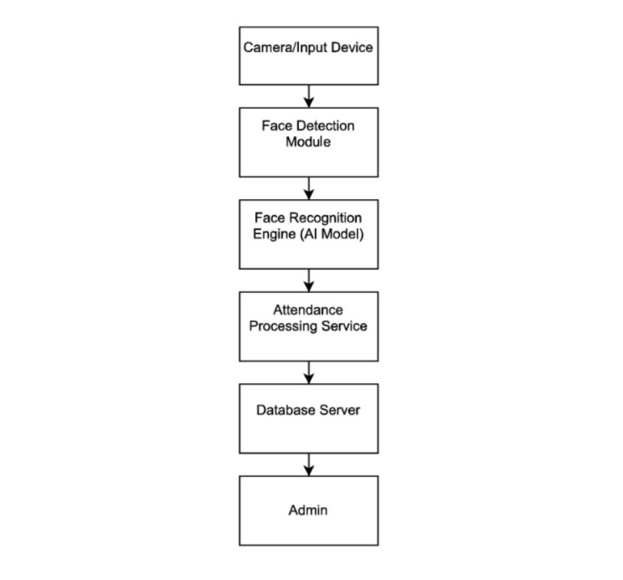
System Design

Slide 14
Algorithm
Deep Face Algorithm:
1. Dataset Preparation
Create a dataset folder containing subfolders for each person with their face images.
Each subfolder name represents the person’s identity (label).
2. Face Detection
Load the InsightFace Face Analysis model (buffalo_l) to detect faces in images.
The model scans the image and locates the face bounding box.

Slide 15
Algorithm
3. Face Alignment
The detected face is aligned using facial landmarks (eyes, nose, mouth) for better accuracy.
4. Embedding Storage
The embeddings are saved in a file (embeddings.pkl) using pickle for later recognition.
5. Live Camera Input
The webcam captures real-time video frames using OpenCV.
6. Face Detection in Live Video
The InsightFace model detects faces in each video frame.

Slide 16
Algorithm
7. Embedding Extraction from Live Face
The system generates embeddings for detected faces in real time.
8. Face Identification
The system assigns the name of the closest matching embedding.
9. Unknown Detection
If no embedding matches the threshold, the person is labeled “Unknown”.
10. Visual Output
The system draws a bounding box and displays the person’s name on the screen.

Slide 17
Algorithm
11. Voice Interaction
The system plays a welcome voice message for recognized persons using text-to-speech.
12. Security Alert
The system triggers a beep alarm when an unknown person is detected.
13. Duplicate Control
A time gap rule (10 seconds) prevents multiple attendance entries for the same person.

Slide 18
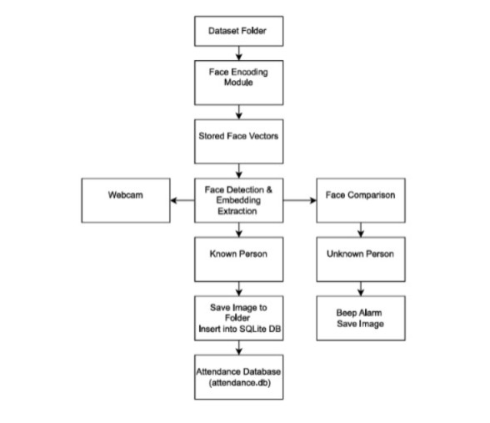
System Implementation (At least 80%)

Slide 19
System Implementation (At least 80%)
1. Dataset Folder:
Contains all registered users’ face images organized (often one folder per person).
Used as the training source for the system to learn facial features.
Images should have clear faces with different angles and lighting.
Each image is labeled with the person’s name or ID.
The face recognition model reads these images to generate face encodings.

Slide 20
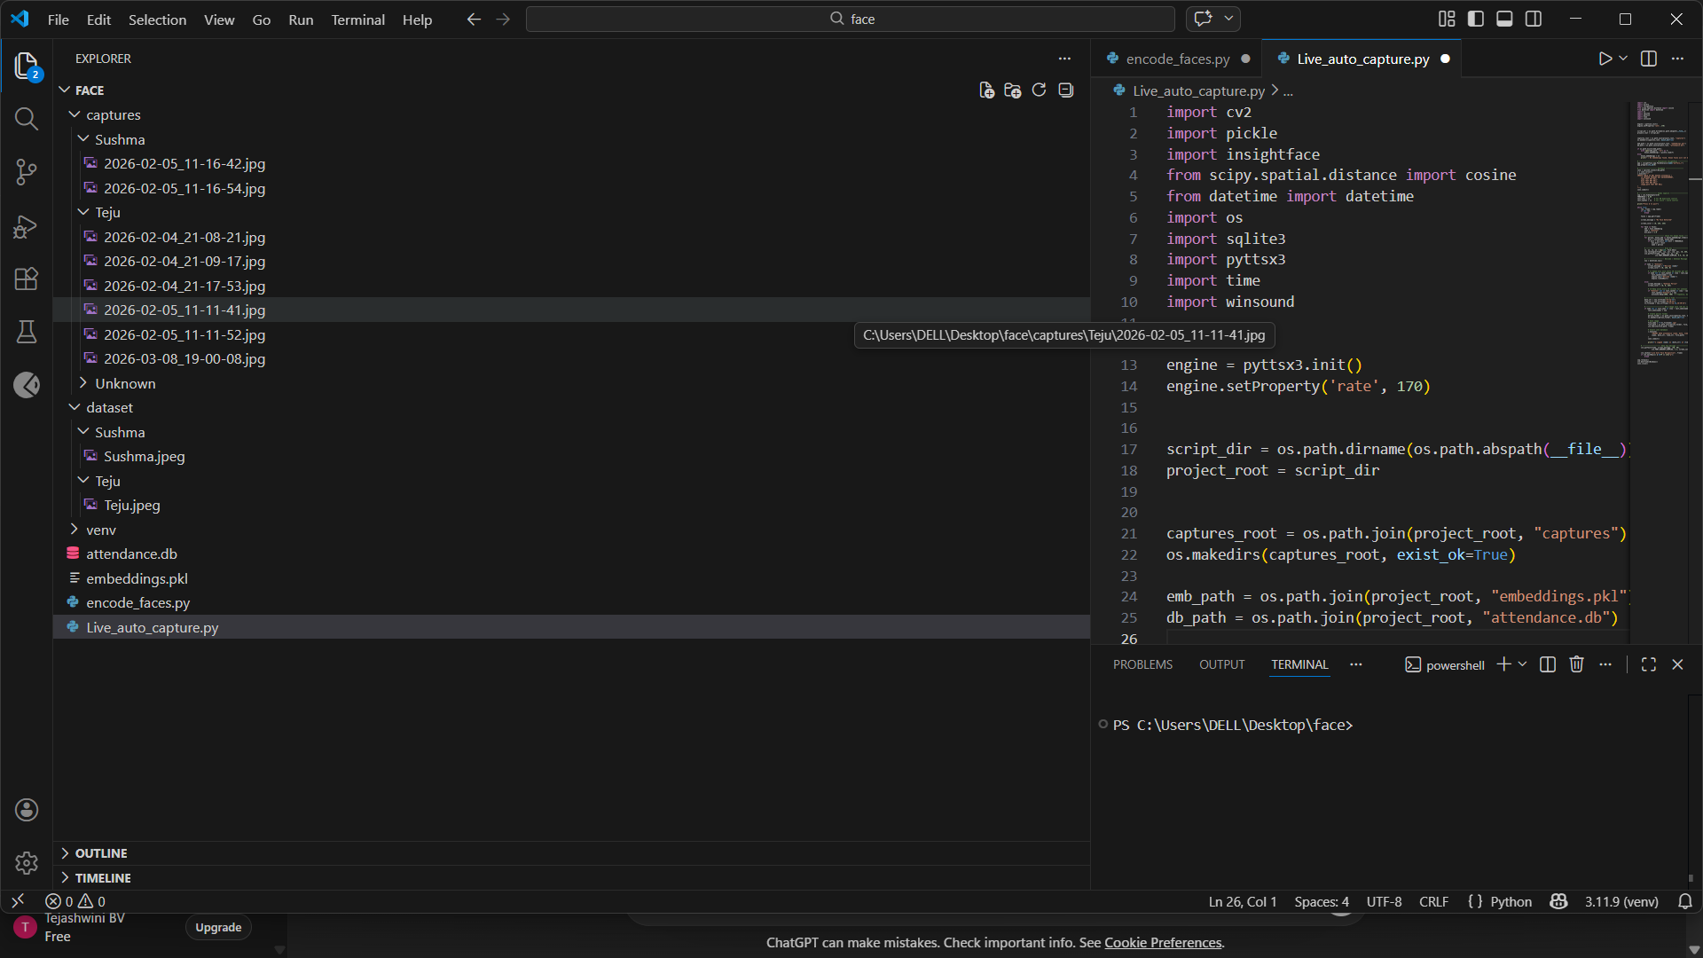
System Execution

Slide 21
System Implementation (At least 80%)
2. Face Encoding Module
Detects faces from images or camera frames using a face detection algorithm.
Extracts unique facial features such as eyes, nose, and face structure.
Converts the detected face into a numerical vector representation.
Uses libraries like OpenCV or face recognition to generate encodings.
These encodings are used to compare and identify faces during attendance.

Slide 22
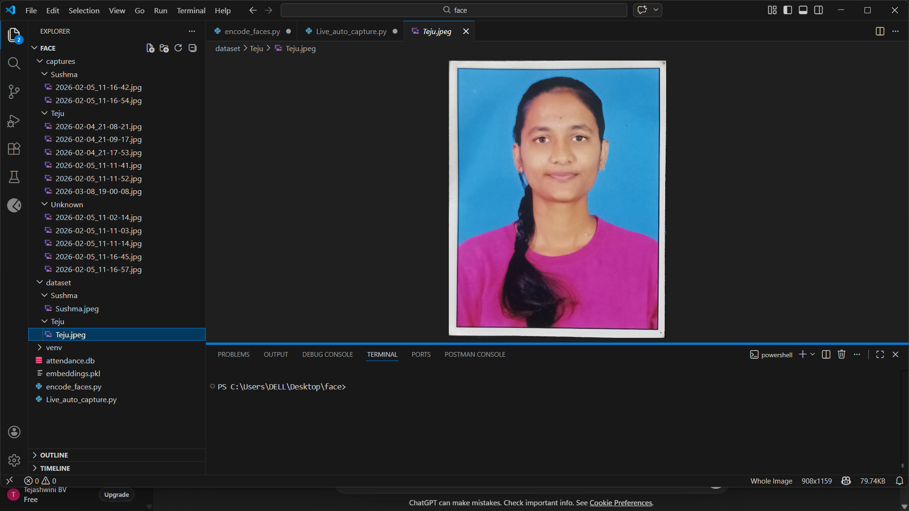
System Execution

Slide 23
System Implementation (At least 80%)
3. Stored Face Vectors
Numerical representations (usually 128-dimension vectors) of each person’s face.
Generated from the dataset images during the encoding process.
Stored in files or databases along with the person’s name/ID.
During recognition, the system compares live face vectors with stored vectors.
If similarity distance is below a threshold, the person is recognized and attendance is marked.

Slide 24
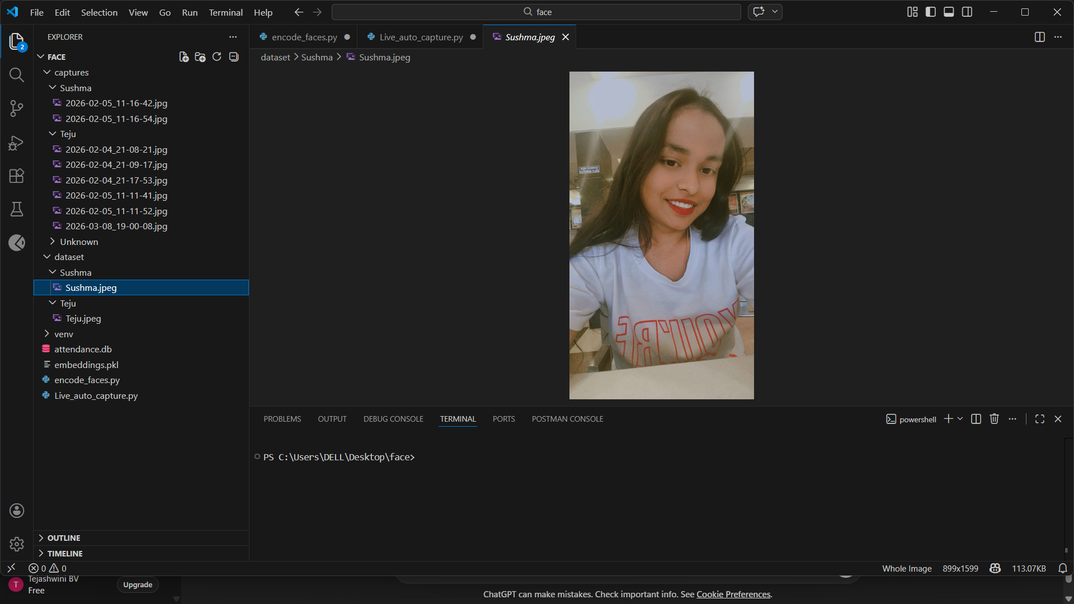
System Execution

Slide 25

System Execution

Slide 26
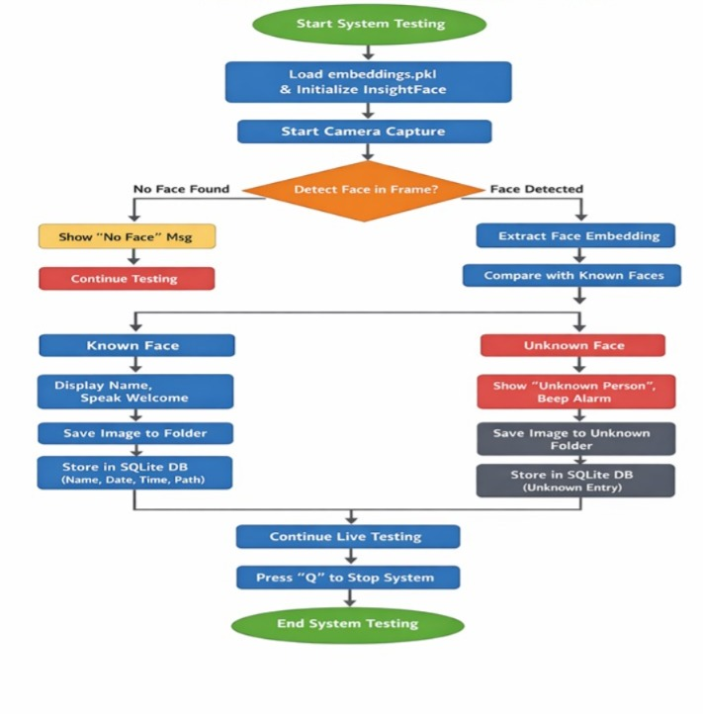
System Testing

Slide 27
Conclusion
Improves attendance accuracy by eliminating manual errors.
Enhances security through reliable face recognition authentication.
Saves time with automated and fast attendance tracking.
Reduces proxy attendance and fraudulent entries.
Provides real-time data and easy report generation.
Minimizes administrative workload and paperwork.
Scalable and adaptable for schools, offices, and organizations.

Slide 28
References
Oladele, K. G., Iseh, E. J., Oladele, J. O., & Bhaladhare, P. R. (2024). AI-Based Face Recognition Attendance System. International Journal of Innovative Research in Multidisciplinary Sciences.
Dixit, H. V., Saxena, A., Arif, & Sharma, S. (2024). Face Recognition-based Attendance System. ICICC Conference Proceedings.
Abderraouf, T., Abdeljalil, W., & Larabi, S. (2024). An Embedded Intelligent System for Attendance Monitoring. arXiv.
Perwej, Y., Trivedi, A., Tripathi, C. M., & Srivastava, A. K. (2022). Face Recognition Based Automated Attendance Management System. International Journal of Scientific Research in Science and Technology.

Slide 29
References
Jadhav, A., Kamble, D., Rathod, S., & Kumar, S. (2024). Attendance Management System Using Face Recognition. IAES International Journal of Artificial Intelligence.
Kunjir, Y., Nikalje, V., Thakur, P., et al. (2024). Facial Recognition Attendance System Using AI. International Journal for Research in Applied Science & Engineering Technology (IJRASET).

Slide 30
Internship Road Map
Note: Write in the below table what u will be achieving in each review
Review 1
Understanding project requirements
Review 2
Understanding project requirements
Review 3
Designing system architecture
Review 4
Final Review
Learning basics of Face Recognition and AI
Studying Python, OpenCV, and Machine Learning concepts
Literature survey and problem identification
Learning basics of Face Recognition and AI
Studying Python, OpenCV, and Machine Learning concepts
Literature survey and problem identification
Developing backend using Flask
Creating frontend using React
Dataset collection and face encoding
Git Hub repository setup
Integrating frontend with backend
Implementing live camera recognition
Testing face detection and attendance marking
Improving accuracy and performance
Complete system deployment
Final testing and validation
Project demonstration
Final report submission
Internship completion

Slide 31
Github Link
https://github.com/tejaswinireddy3232-blip/Internship

Slide 32
Q&A

Slide 33
Thank you !!

